Slide 1


Pepper Workshop

Slide 2
Agenda
Who are we?
What can you do with Pepper?
Hardware
NAOqi API and documentation
Choregraphe
Let’s have a look at an example!
Useful tips
Any questions?

Slide 3
Who are we - Avatarion
founded in 2015
Swiss distributor of SoftBank robots
Junior partner of Raiffeisen
specialized in creating robotic applications and solutions accessible through different devices and accessories

Slide 4
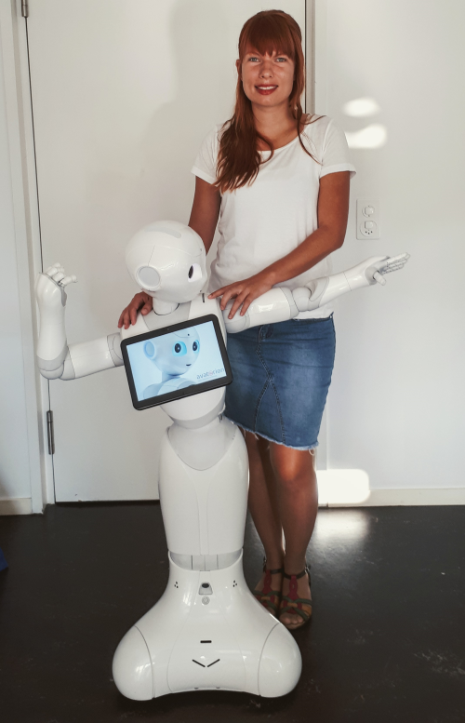
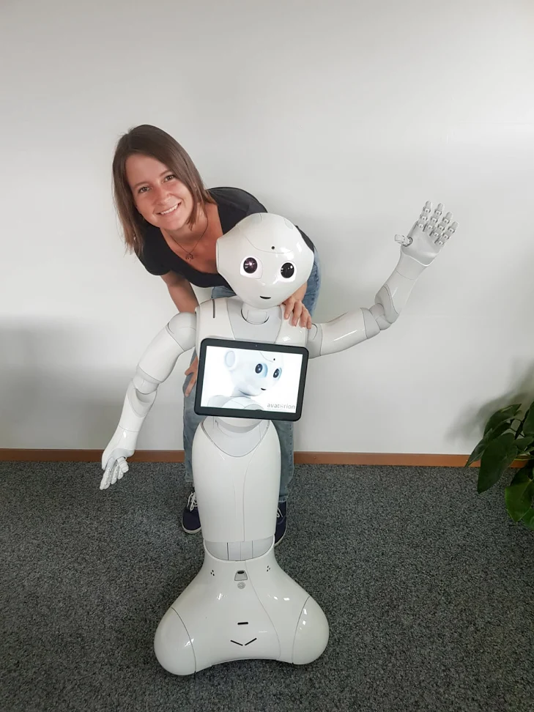

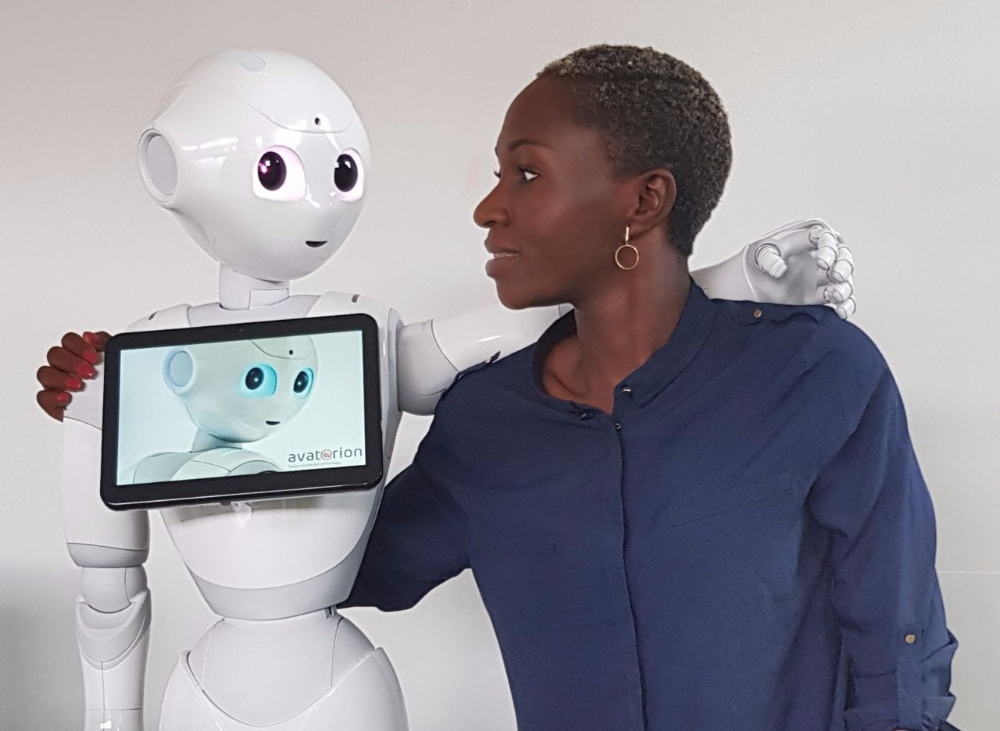
Who are we? - Developers + Support
Michelle
Software Developer
Ludivine
Software Developer
Jessica
Software Developer
Claudio
Hardware & Support

Slide 5
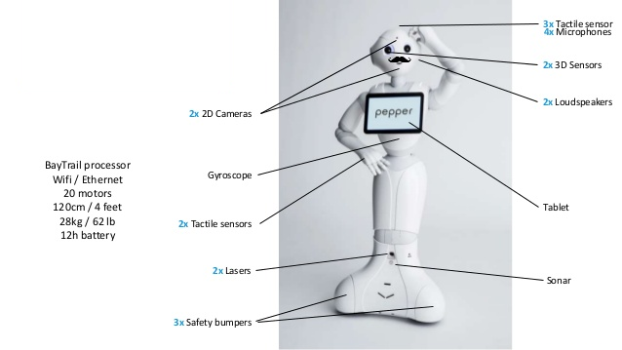
What can you do with Pepper - Hardware
Technical documentation

Slide 6
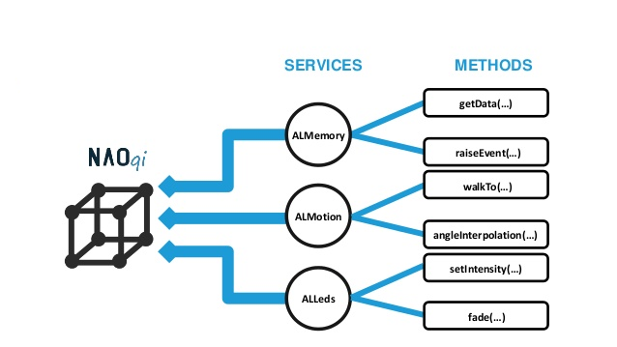
What can you do with Pepper - NAOqi
NAOqi API

Slide 7

What can you do with Pepper - Choregraphe
Choregraphe is a multi-platform desktop application, allowing you to:
Create animations, behaviors and dialogs,
Test them on a simulated robot, or directly on a real one,
Monitor and control your robot,
Enrich Choregraphe behaviors with your own Python code.

Slide 8
What can you do with Pepper - Choregraphe
How to get Choregraphe:
Create a SoftBank user account for free: https://community.ald.softbankrobotics.com
Download Choregraphe for Windows, Linux or Mac from here: https://community.ald.softbankrobotics.com/en/resources/software/language/en-gb/field_software_type/choregraphe
License key is available on the same page

Slide 9
Let’s have a look at an example!
Choregraphe project example explains, how to use:
Animation
Behavior
Dialog
Website: HTML/CSS/JavaScript
Manifest: Project Properties

Slide 10
Useful tips
Voice
use short sentences
no long lasting monologues → dialogs to engage people in a conversation
style Pepper’s voice with breaks, voice pitch
use animated say and animations (movements, leds, tablet), to make the interaction more alive

Slide 11
Useful tips
Sounds
Use sounds to mark relevant moments
Soundsetaldebaran provides many cool robot sounds
Tablet
Use tablet to animate the robot or as a dialog fallback
Tablet apps should be multimodal (using speech recognition and tablet events)

Slide 12
Useful Tips
Putty
Download from https://www.putty.org/
SSH access to the robot
login: nao, password: nao
use qicli

Slide 13
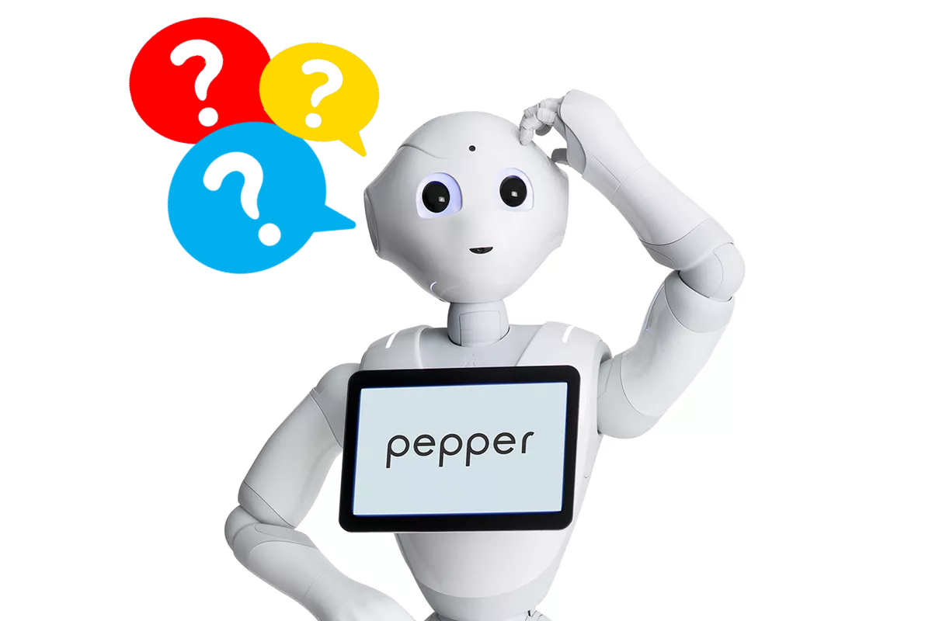
Any questions?

Slide 14
Thank you!

